Slide 1
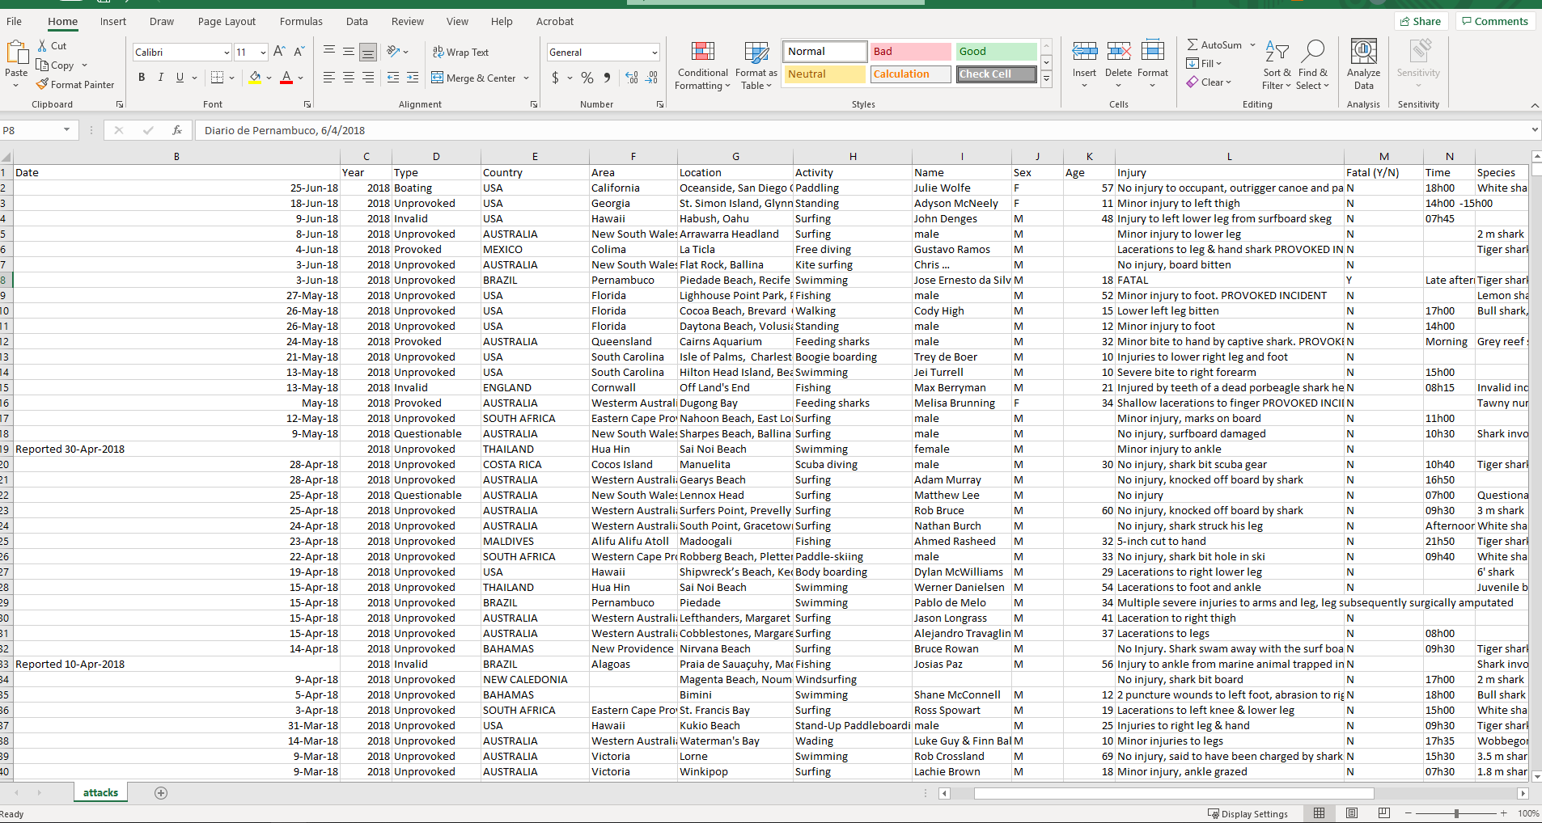
The Data

Slide 2
Questions we want to answer:
What factors increase likelihood of a fatal shark attack?
Does gender increase your likelihood of death?
What are the deadliest species of shark?
What country is the deadliest?
What activity puts you most at risk?

Slide 3
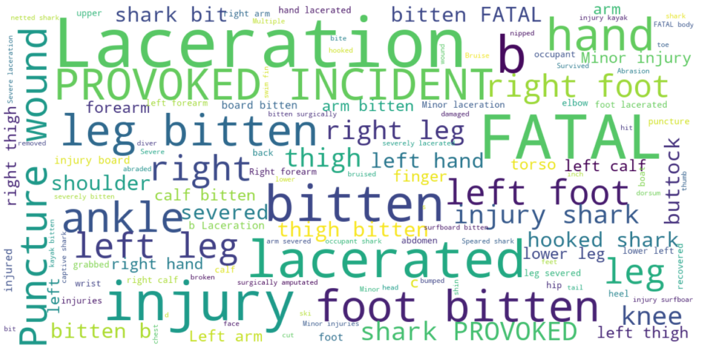
Word Cloud of injuries from shark attacks

Slide 4
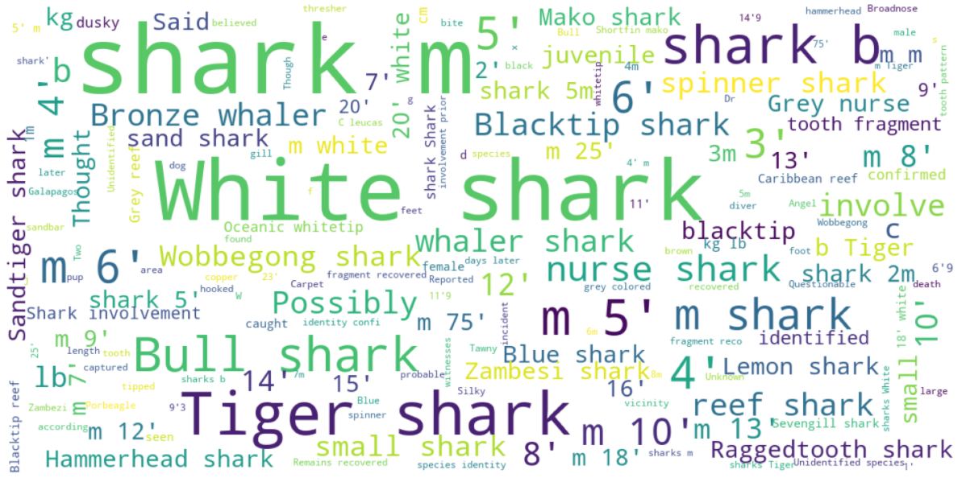
Word Cloud of types of shark

Slide 5
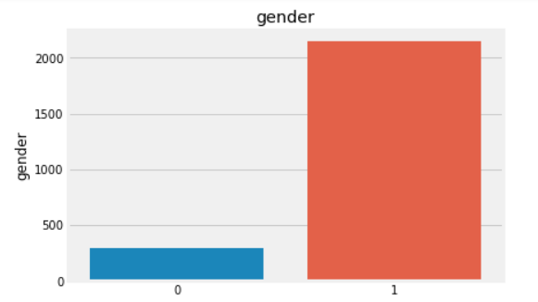
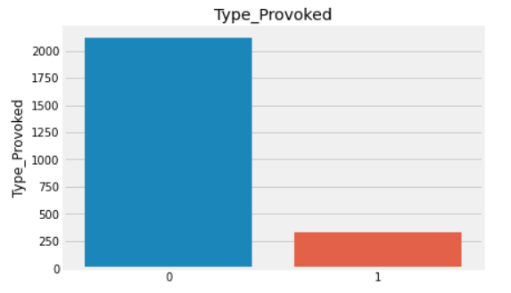
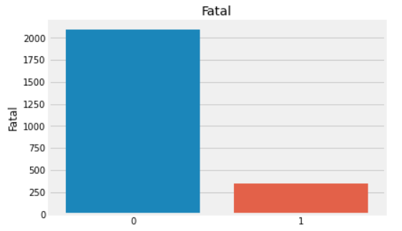
Gender
Provoked
Fatal

Slide 6
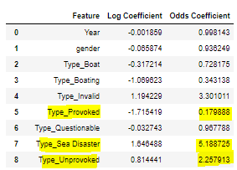
Logistic Regression
Compute likelihood of death from shark attack
Feature engineering
Country
Type
Species
Activity

Slide 7
Things to improve
Country proportionality
Data Cleansing
Missing values
Species and type conversion
Better understanding of data

Slide 8
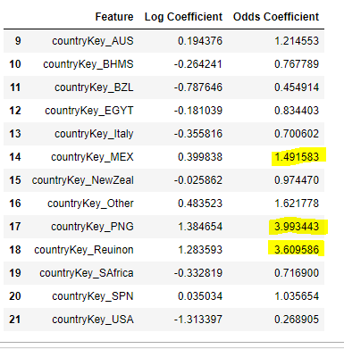
If the shark attack was fatal
Countries with increased chance:
- MEX
- Reunion
- PNG

Slide 9
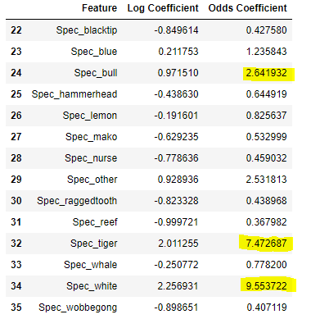
If the shark attack was fatal
Species causing highest increased chance of death:
- Bull
- Tiger
- White

Slide 10
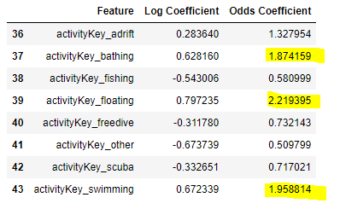
If the shark attack was fatal
Activities with highest increase on death:
- Floating
- Swimming
- Bathing

Slide 11
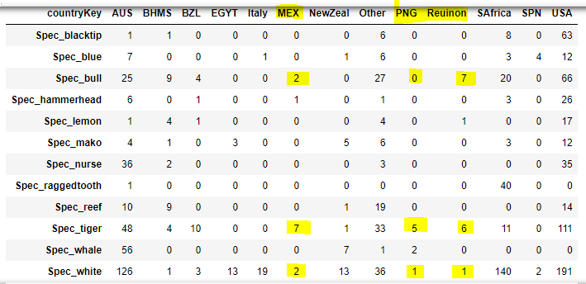
Do the “deadliest” countries have the “deadliest” species of sharks?
All but 1 attack in top 3 countries were from our deadliest sharks
Yes, deadliest countries have the deadliest shark attacks

Slide 12
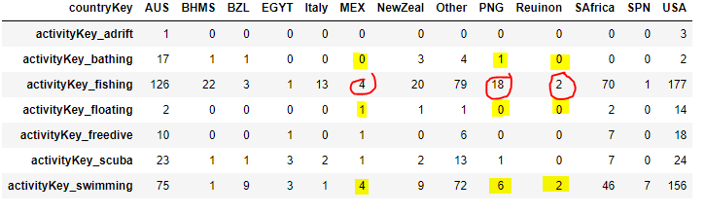
Do the deadliest activities take place in the deadliest countries?
Swimming is one of the highest in all 3
Fishing is the most prominent in all 3
An activity may have more attacks, but attacks may not be fatal

